Slide 1


Garbage monitoring using Arduino
by
KISHORE G
YOGESH KUMAR M.P
ATHUL SURIYAKIRON
GREESHMANTH .K

Slide 2
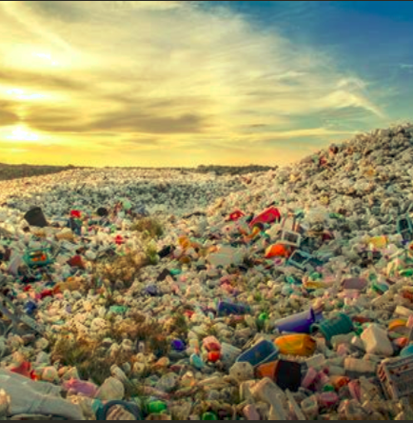
Wiki’s definition
Waste (Or Wastes) Are Unwanted Or Unusable Materials. Waste Is Any Substance Which Is Discarded After Primary Use, Or Is Worthless, Defective And Of No Use.
waste

Slide 3





The Problem
Over Flow
Time
Health
Cost
Fire
Excess Trash In Bins Can Result In Poor Ambience
Time Management For Monitoring Bin Levels Is Unregulated
Unmonitored Trash Bin Is A Serious Threat To Our Health
The Fleet Fuel Expenditure Is High
Half Burnt Cigarettes Or Any Explosive Waste In Bins May Result In Accidental Fire

Slide 4



Solution
These problems can be solved by utilizing or integrating smart technology Into trash bins
Arduino
IOT
Alarm
A Microcontroller Used For Controlling Actions Of Other Module
The Ability To Transfer Data Over A Network Without Requiring Interaction.
This Alerts The User By The Means Of LED Signaling

Slide 5
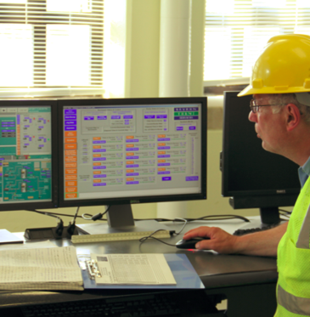
Garbage Monitoring
System
Garbage Monitoring System(GSM) Is An Ingenious System Which Will Help To Keep Cities Clean.
GSM Monitors Smart Trash Bins And
Informs About The Level Of Garbage Collected In Those Bins.
Also Monitors Temperature In Realtime And Notifies In Case Of Fire
A Contemporary Solution For Managing Waste In An Economically Efficient Manner So As To Make Waste Disposal Organized And Hassle Free.

Slide 6



Block Diagram
Alert System
Temperature Sensor
The User Is Notified Through Led
Reads The Temperature Using US-100
Proposed Model For This Project
Distance Measure
Arduino
Measures Distance Using US-100
A Microcontroller Which Controls The entire Process Using ESP8266

Slide 7
Materials Required
US-100
Node MCU ESP8266
Trash
Can

Slide 8
Methodology
The System Development Is Split Into Three Phases :
Phase 2
Phase 3
Phase 1
The Node MCU ESP8266 Is Coded With LED Blink Test To Check If The Microcontroller Is Working Or Not
Once The Working Is Verified We Start Connecting The Circuit
The Node MCU Is Connected To US-100
  EVCC – 3.3V
  GND – GND
  D1 – ECHO
  D2 – TRIG
Then the Node MCU is connected to a laptop using a micro USB cabel and coded using Arduino IDE :
if((mmDist > 1) && (mmDist < 10000)) {
Serial.print("Distance: ");
if(mmDist>25){
Serial.print("TRASH IS EMPTY");
digitalWrite(LED_BUILTIN, HIGH);}
else {Serial.print("TRASH IS FULL ");
digitalWrite(LED_BUILTIN, LOW);} } }

Slide 9
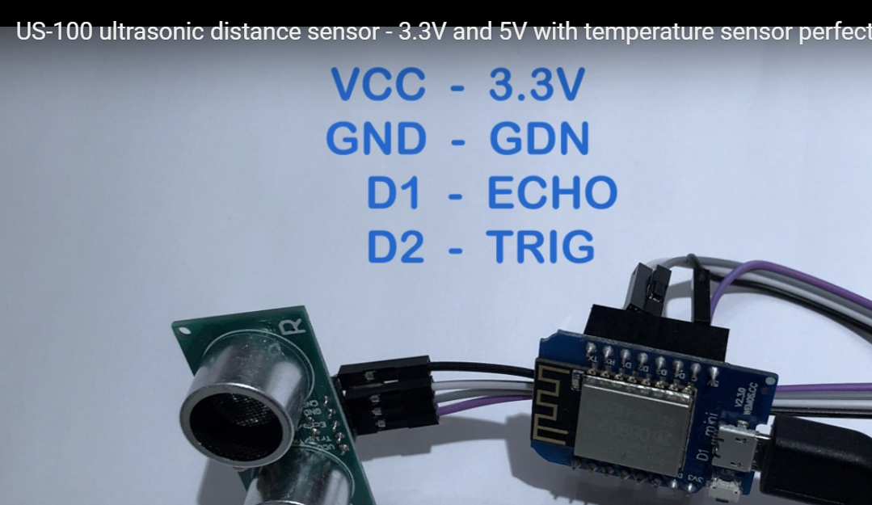

Slide 10

Application
Can Be Used In
Household, Shopping Malls And
Apartment Premises
Municipalities And Corporation Roads
Hospitals, Office And Other Commercial Establishments
Other Benefits Include:
Proper Waste Management.
Safty From Fire Spread.
Improves Hygine

Slide 11

Team
Project Task Division :
Kishore .G
Athul Suriyakiron
Yogesh Kumar M.P
Greeshmanth .K
AM.EN.U4ECE16127
AM.EN.U4ECE18501
AM.EN.U4ECE16163
AM.EN.U4ECE16125
  Circuit algorithm
  Ultrasonic Sensor And Arduino Algorithms
  Trial & Error Test With The Coded Algorithm.
  Debugging
  Component Purchase
  User Methodology And Its Working Mechanism
  Circuit Design
  Analyze The Working Model For Any Possible Upgradation

Slide 12
VIDEO

Slide 13

Conclusion
Efficient & economical Waste Management improves proper waste disposal which will accelerate the efforts to achieve an eco-friendly nation. Sustainability can be achieved with devoted positive human intervention.
Every drop in the ocean counts. We believe our project counts for a larger universal cause and effect.
One Step Towards Cleanliness (Endorse Swachh Bharat Abhiyan)
Efficient Waste Management
Clean Surroundings
Fire Detection & Prevention Bins
Economical Garbage Monitoring

Slide 14
Thank You

